Slide 1
Introduction To R
EPA’s Emerging Leaders Network 2021-02-24 Jeff Hollister, ORD/CEMM/ACESD

Slide 2

Who am I?
Landscape ecology/GIS/Lakes/Data Science
US EPA Research Ecologist since ~2006
Worked on: Forests, wetlands, gopher tortoise, estuaries, lakes, cyanobacteria, …
useR since 2000 (yikes!)
Jeff in the jon boat

Slide 3

What is R?
“Free software environment for statistical computing and graphics”
Dialect of the S language
Written by Ross Ihaka and Robert Gentleman
First Release in 1993, version 1.0 in 2000
Current version 4.0.4 (aka “Lost Library Book”) released Feb 2021.
Fully functional, general purpose programming language
Excels at statistics and visualization
Why is it called “R”?

Slide 4
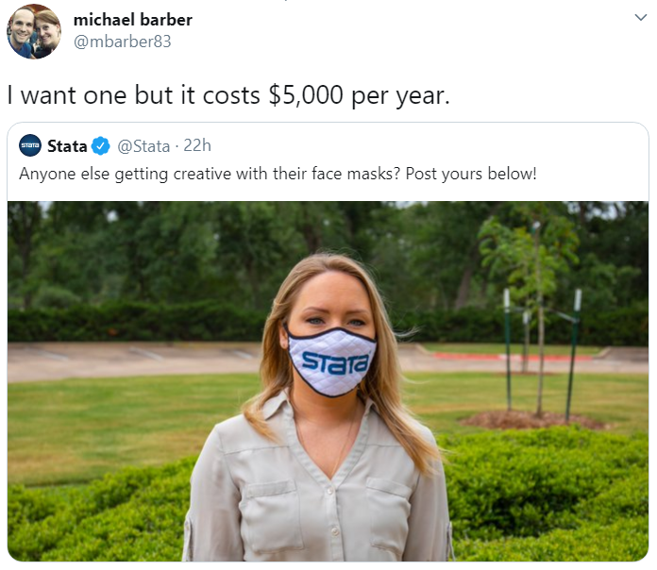
Why use R?
Free!
Statistics and Graphics
GIS/Spatial
Writing Papers
Presentations (like this one)
Develop new tools
Reproducibility
Open Science

Slide 5

R vs. Python

Slide 6

R vs. & Python

Slide 7
- Panel discussion from yesterday!: https://www.youtube.com/watch?v=6mp-BWPnqK4

Slide 8

R and EPA
Large and active community
January 2019 ~900 installations at EPA (HQ offices only)
R Users Group
Teams channel in the Data Science team
Sharepoint (legacy)
Monthly meetings
Installation (for HQ Offices, regions are Ad hoc)
R
RStudio
Rtools (required build tools for Windows)

Slide 9
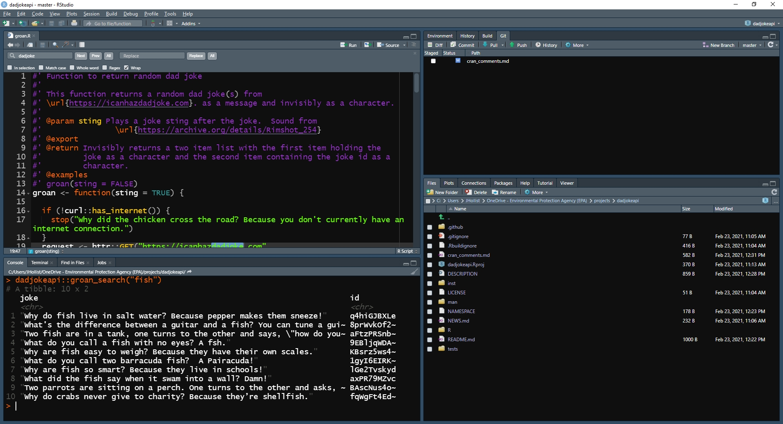
RStudio
Integrated Development Environment
Also a company that supports the R community
RStudio 1-minute Demo

Slide 10
Base R
Fresh out of the box you get 6618 functions!
You can do a lot
stats, graphics, parallel computing, …
Base R 1-minute Demo

Slide 11


Slide 12
Extending Base R: Packages
Community developed extensions
Many quality checks
Two main sources
CRAN (https://cran.r-project.org/): 17147 packages
Bioconductor (https://www.bioconductor.org/): 20463 packages
Genomics/bioinformatics

Slide 13


Slide 14
What can you do with R?
Well-known:
Statistics
Graphics
Less well-known:
Geospatial/GIS
Documents (e.g. word, pdf, ppt)
Web applications
Off-beat things

Slide 15
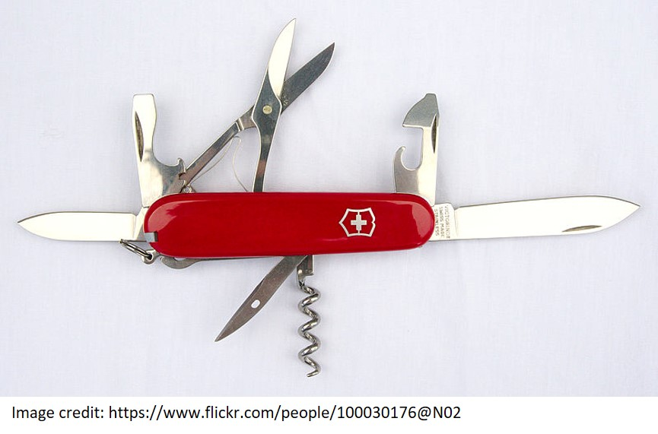

Slide 16
Offbeat things you can do with R
beepr: Easily Play Notification Sounds on any Platform
BRRR: Rap adlibs in R
dadjokeapi: Return a Dad Joke
demotivr: Show Demotivational Messages on Errors
kittyR: Kitty pictures and meows from R console
praise: Praise Users
memer: A tidyverse compatible package for creating memes in R using magick
rainbowwrite: Rainbow Coloured Output
wesanderson: A Wes Anderson Palette Generator
# Noises! beepr::beep(2) BRRR::skrrrahh() kittyR::meowR(4) BRRR::skrrrahh(16) # Messages dadjokeapi::groan() praise::praise() demotivr::nothing_matters() # Images and colors library(magrittr) meme_get("DosEquisMan") %>% meme_text_top("I don't always useR!", size = 28) %>% meme_text_bottom("But when I do, I procrastinate\nby making memes.", size = 28) joke <- dadjokeapi::groan(FALSE)$joke rainbowrite::lolcat(joke)

Slide 17
Statistics 1 minute demo
library(readr) nla_wq <- read_csv("https://www.epa.gov/sites/production/files/2014-10/nla2007_chemical_conditionestimates_20091123.csv") nla_wq <- nla_wq[complete.cases(nla_wq[,c("CHLA", "PTL", "NTL")]),] mean(nla_wq$CHLA) t.test(nla_wq$CHLA ~ nla_wq$LAKE_ORIGIN) nla_lm <- lm(log10(CHLA) ~ log10(PTL) + log10(NTL), data = nla_wq) summary(nla_lm)

Slide 18
Visualization 1 minute demo
library(ggplot2) nla_wq %>% ggplot(aes(x=NTL,y=PTL)) + geom_point(aes(size=CHLA, color=CHLA)) + scale_x_log10() + scale_y_log10() + scale_color_continuous(low = "springgreen", high = "darkgreen") + geom_smooth(method = "lm", color = "grey50") + theme_classic() + labs(title = "Total Nitrogen, Total Phosphorus, and Chlorophyll Associations", x = "Log 10 (Total Nitrogen)", y = "Log 10 (Total Phosphorus)")

Slide 19
Geospatial 1 minute demo
library(USAboundaries); library(sf); library(dplyr); library(elevatr); library(mapview); library(raster) # Get map of lower 48 states usa_l48 <- us_boundaries() %>% filter(state_abbr != "HI" & state_abbr != "AK" & state_abbr != "PR") # Get DEM. Zoom level 4 returns dem of ~ 3.8km resolution for whole of lower 48 usa_l48_dem <- get_elev_raster(as(usa_l48, "Spatial"), src="aws", z = 4, clip = "location") mapview(usa_l48_dem) + usa_l48

Slide 20
Documents 1 minute demo
R mixed with Markdown: https://daringfireball.net/projects/markdown/
PDF
Word Documents
Presentations

Slide 21
Web 1 minute demo
Shiny
Shiny examples: https://shiny.rstudio.com/gallery/
Shiny at EPA
https://shiny.epa.gov/fcedts/
Internal at NCC
Working on other options
Web and HTML tools galore
Visualization
Web Scraping
APIs

Slide 22
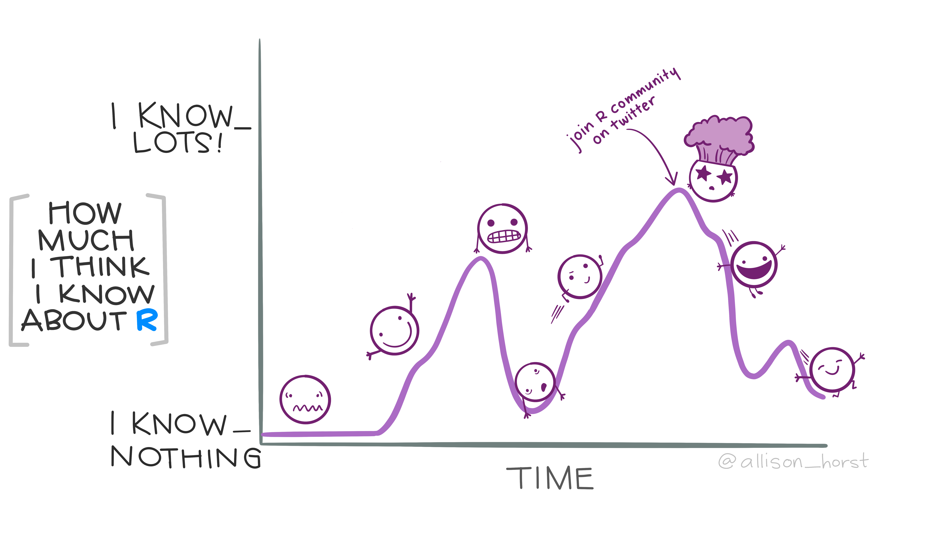
Learn More
Twitter
#rstats
#TidyTuesday
#rspatial
EPA R User Group
Monthly Meetings
Face to face meeting every 2 years
September, but we’ll see…
learnr: https://rstudio.github.io/learnr/
The Carpentries: https://carpentries.org/

Slide 23
Questions

